Slide 1
Global 3D Camera
A glimpse of now and next
Ding
2024/Q2

Slide 2
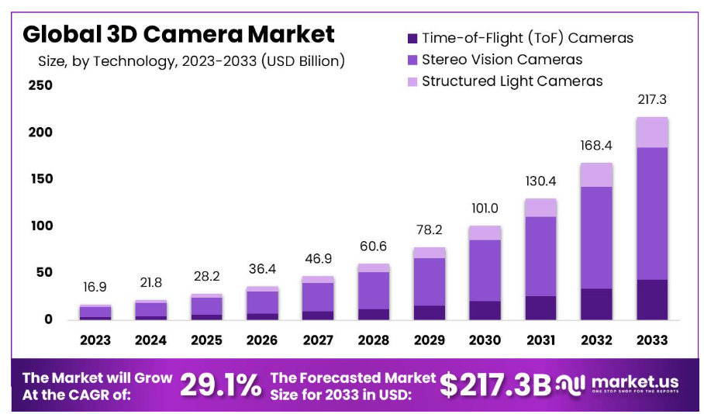
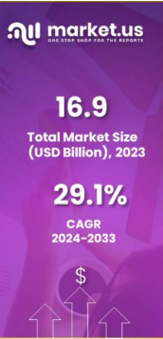
3D Camera Market Growth Overview
CAGR 14.08%
https://market.us/report/3d-camera-market/
3D cameras are designed to capture images and videos in three dimensions, providing depth perception for a more immersive visual experience.

Slide 3
3D Camera Market Growth Overview
3D cameras are designed to capture images and videos in three dimensions, providing depth perception for a more immersive visual experience.
https://market.us/report/3d-camera-market/
1
The 3D Camera market is expected to grow by 29.1% from 2024 until 2033.
2
The market’s value for 2023 stood at USD 16.9 billion and is projected to be USD 217.3 billion in 2033.

Slide 4
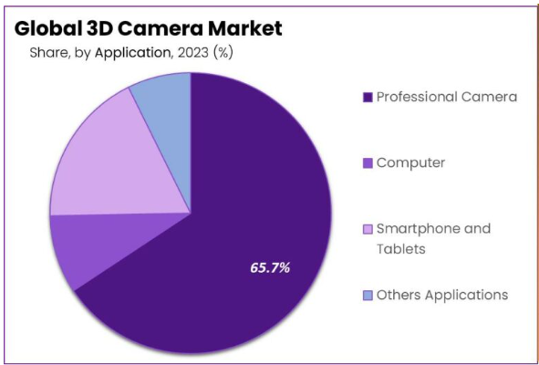
3D Camera Driving Factors 2023
|
2023 Status Quo
Applications of 3D Cameras
Major applications include 3D modeling and design, augmented/virtual reality experiences, post-production VFX, and facial recognition.
Regional Dynamics
Asia Pacific emerged as the dominant player, capturing over 38.2% of the market share, driven by a robust manufacturing ecosystem and the adoption of 3D imaging technologies.
Key Market Players
Major players in the 3D camera market include Sony Corporation, Fujifilm Holdings Corporation, Panasonic Corporation, Canon Inc., Nikon Corporation, GoPro, Inc., and Samsung Electronics Co., Ltd.
Consumer Demand for Enhanced Imaging:
The increasing demand for high-quality 3D imaging in smartphones, tablets, and digital cameras is a major driving force.
Consumers seek immersive experiences and innovative photography capabilities, spurring manufacturers to integrate 3D cameras into their devices.
Growth of AR and VR:
The proliferation of AR and VR applications across diverse industries, including gaming, healthcare, and education, is driving the uptake of 3D cameras.
These cameras play a crucial role in crafting lifelike and interactive virtual environments, ultimately elevating user experiences.
Industrial Automation and Robotics:
In industrial sectors, the need for automation, quality control, and precise object recognition is driving the demand for 3D cameras.
They play a vital role in applications like robotic assembly lines, ensuring efficiency and accuracy.
Advancements in Automotive Safety:
Advanced Driver Assistance Systems (ADAS) and autonomous vehicles depend on 3D cameras for functions such as depth perception, object detection, and collision avoidance.
The increasing focus on vehicle safety and advancements in self-driving technology is driving the widespread adoption of 3D cameras in the automotive industry.
1
Challenges:
Challenges in calibration and accuracy, data processing complexity, interoperability, and ethical considerations are factors that need to be addressed in the 3D camera market.
2
Future Trends:
Depth sensing for photography and LiDAR integration are prominent trends in the 3D camera market.

Slide 5
3D Camera Driving Factors(2023)
Consumer Demand for Enhanced Imaging:
The increasing demand for high-quality 3D imaging in smartphones, tablets, and digital cameras is a major driving force.
Consumers seek immersive experiences and innovative photography capabilities, spurring manufacturers to integrate 3D cameras into their devices.
Growth of AR and VR:
The proliferation of AR and VR applications across diverse industries, including gaming, healthcare, and education, is driving the uptake of 3D cameras.
These cameras play a crucial role in crafting lifelike and interactive virtual environments, ultimately elevating user experiences.
Industrial Automation and Robotics:
In industrial sectors, the need for automation, quality control, and precise object recognition is driving the demand for 3D cameras.
They play a vital role in applications like robotic assembly lines, ensuring efficiency and accuracy.
Advancements in Automotive Safety:
Advanced Driver Assistance Systems (ADAS) and autonomous vehicles depend on 3D cameras for functions such as depth perception, object detection, and collision avoidance.
The increasing focus on vehicle safety and advancements in self-driving technology is driving the widespread adoption of 3D cameras in the automotive industry.
|
2023 Status Quo
Applications of 3D Cameras
Major applications include 3D modeling and design, augmented/virtual reality experiences, post-production VFX, and facial recognition.
Regional Dynamics
Asia Pacific emerged as the dominant player, capturing over 38.2% of the market share, driven by a robust manufacturing ecosystem and the adoption of 3D imaging technologies.
Key Market Players
Major players in the 3D camera market include Sony Corporation, Fujifilm Holdings Corporation, Panasonic Corporation, Canon Inc., Nikon Corporation, GoPro, Inc., and Samsung Electronics Co., Ltd.
1
Challenges
Challenges in calibration and accuracy, data processing complexity, interoperability, and ethical considerations are factors that need to be addressed in the 3D camera market.
2
Future Trends
Depth sensing for photography and LiDAR integration are prominent trends in the 3D camera market.
Notes:
Consumer Demand for Enhanced Imaging:
The increasing demand for high-quality 3D imaging in smartphones, tablets, and digital cameras is a major driving force.
Consumers seek immersive experiences and innovative photography capabilities, spurring manufacturers to integrate 3D cameras into their devices.
Growth of AR and VR:
The proliferation of AR and VR applications across diverse industries, including gaming, healthcare, and education, is driving the uptake of 3D cameras.
These cameras play a crucial role in crafting lifelike and interactive virtual environments, ultimately elevating user experiences.
Industrial Automation and Robotics:
In industrial sectors, the need for automation, quality control, and precise object recognition is driving the demand for 3D cameras.
They play a vital role in applications like robotic assembly lines, ensuring efficiency and accuracy.
Advancements in Automotive Safety:
Advanced Driver Assistance Systems (ADAS) and autonomous vehicles depend on 3D cameras for functions such as depth perception, object detection, and collision avoidance.
The increasing focus on vehicle safety and advancements in self-driving technology is driving the widespread adoption of 3D cameras in the automotive industry.

Slide 6
3D Camera Growth Opportunities
a
Healthcare Imaging
The healthcare sector offers significant growth opportunities for 3D cameras in medical imaging, surgical navigation, and patient monitoring.
The ability to capture precise 3D anatomical data enhances diagnostics and treatment.
Customized 3D Scanning Solutions
Tailoring 3D camera solutions for specific industries, such as manufacturing and architecture, presents opportunities for providers to meet specialized needs and gain a competitive edge.
Miniaturization and Wearable Devices
Advancements in miniaturizing 3D camera technology open doors for wearable devices and applications like AR glasses, where compact and lightweight cameras are essential.
AI Integration
Integrating artificial intelligence (AI) with 3D cameras for real-time object recognition and analysis enhances their capabilities.
This integration can drive growth in applications like retail analytics and security.
b
c
d

Slide 7
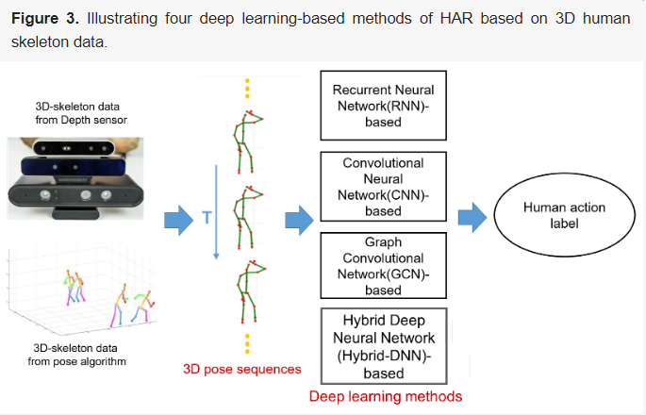
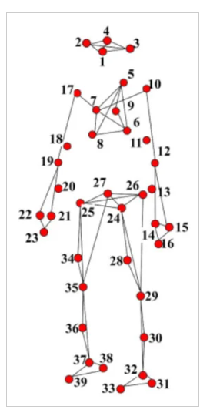
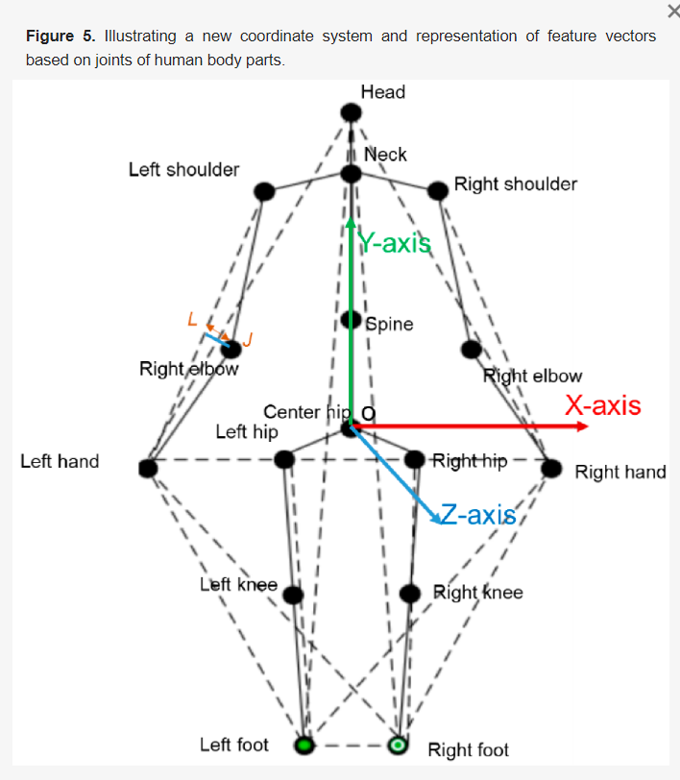
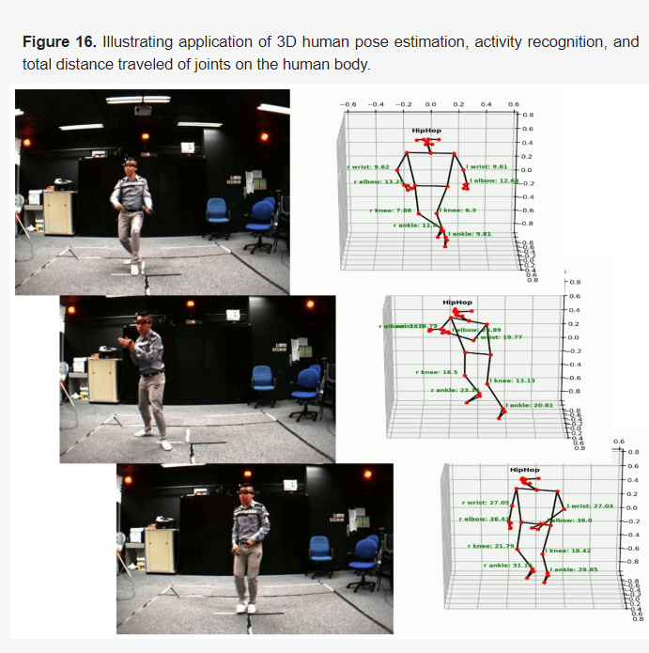
3D Camera Application with Artificial Intelligence (AI)

Slide 8
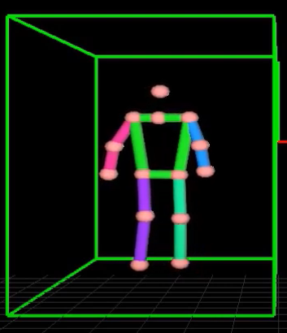
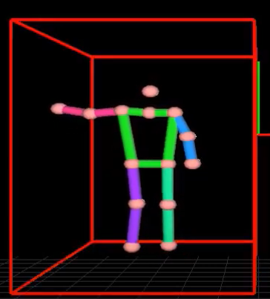
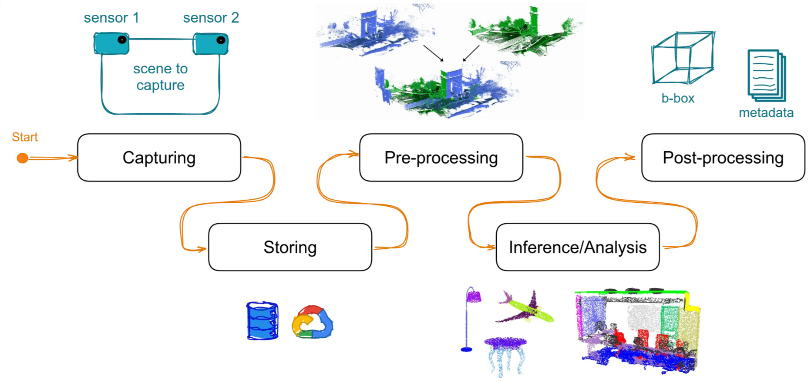
3D Camera Application with Artificial Intelligence (AI)

Slide 9
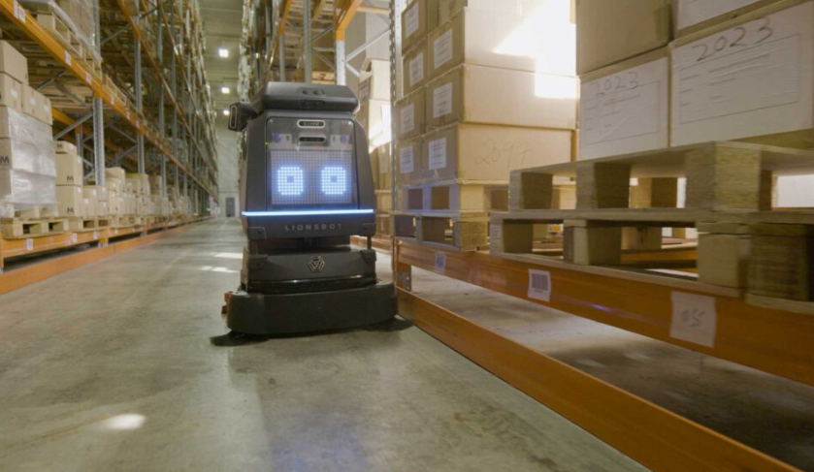
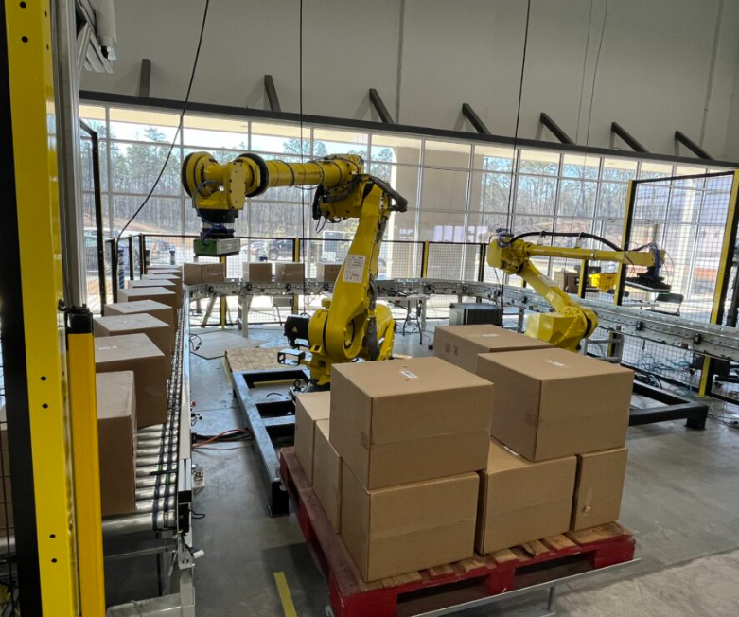
3D Camera Applications
|
Robotics
|
Robotics
工廠自走清潔機器人
Lionsbot
自動撿貨
Pelican Robotics
Solomon
Notes:
The R3 Scrub Pro: Pro Cleaning Made Easy (youtube.com)
Yaskawa Robot Demo at Pelican Systems (youtube.com)
Dual Robot Arm Bin Picking Demo | AccuPick (youtube.com)

Slide 10

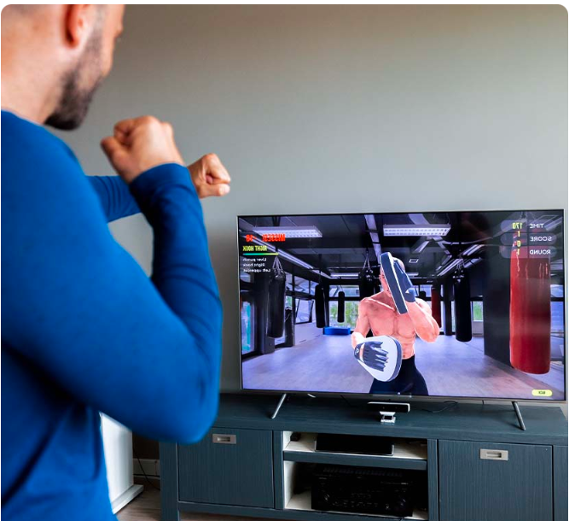
3D Camera Applications
|
Health Tech
|
Fitness
互動復健
MIRA software platform
互動運動/遊戲
Fittar smart box
Notes:
https://www.youtube.com/watch?v=RcGDS6iFXM8
https://www.youtube.com/watch?v=pK-AJ1b6AwM

Slide 11
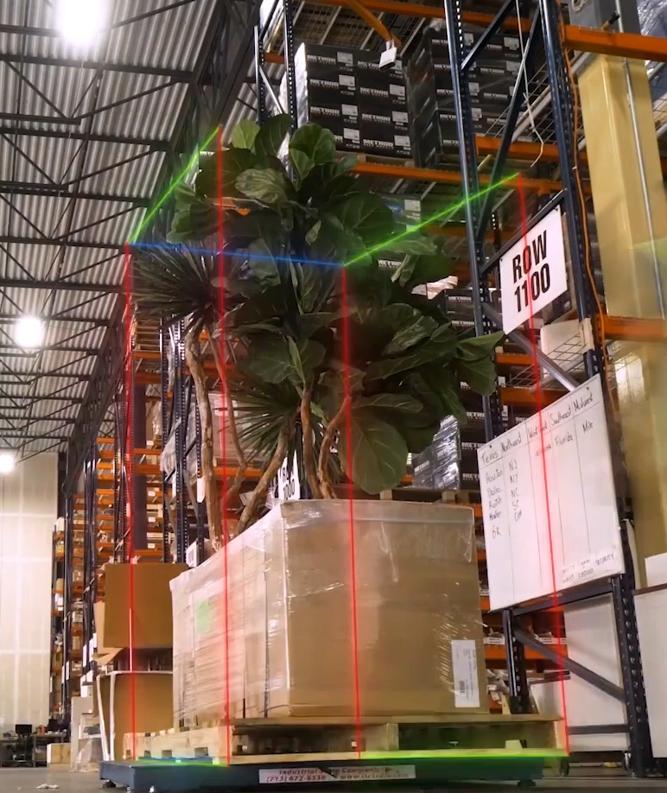
3D Camera Applications
|
Logistic
貨品尺寸自動量測
Cargo Spectre
Notes:
https://www.youtube.com/watch?v=v-OQgIvWjZ4

Slide 12


有其他問題嗎？
Solomon AI and 3D Vision - YouTube

Slide 13
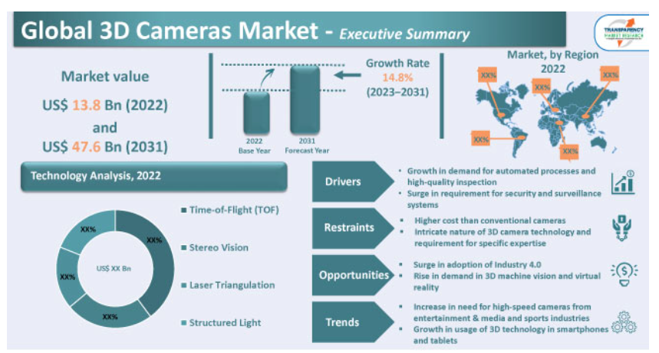
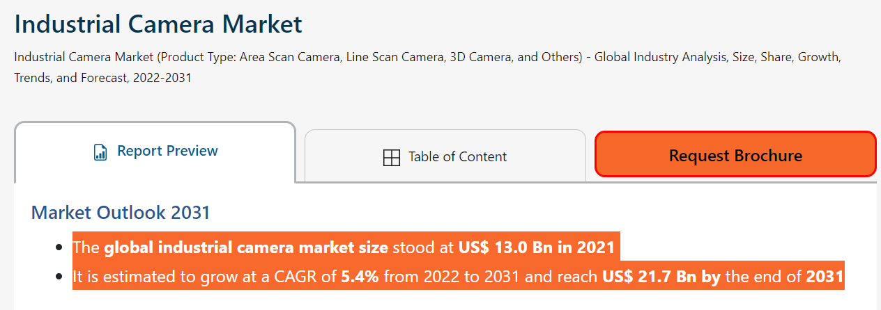
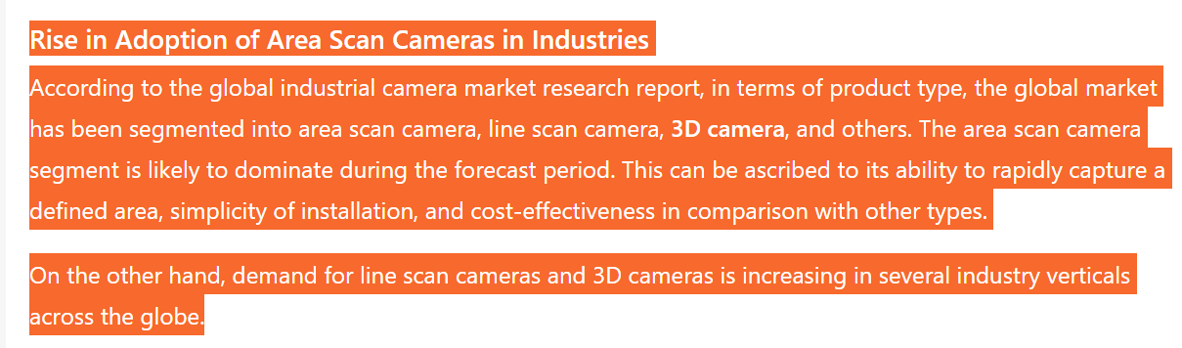
3D Camera Market Growth Overview
https://www.transparencymarketresearch.com/industrial-camera-market.html
https://www.transparencymarketresearch.com/3d-cameras-market.html
The global industry was valued at US$ 13.8 Bn in 2022.
It is estimated to advance at a CART of 14.08% from 2023 to 2031.
The value reaches US$ 47.6 Bn in 2031.

